Slide 1
Institute for Cyber-Enabled Research
Dr. Dirk Colbry
Director, High Performance Computing Center
© 2014 Michigan State University Board of Trustees.
Notes:
Hello my name is Dirk Colbry and today I will be giving you a brief overview of the computational resources and support that are available to faculty on campus. The goal of iCER is to help the MSU research community utilize advanced computational hardware in their research.

Slide 2
Agenda
What is iCER / HPCC
Common classes problems
Overview of Hardware
Getting started, Seven Steps to High Performance
Running in parallel
Tips and tricks
Notes:
I designed this to be a high level talk to discuss the types of advanced computing resources that are available and how to get started and use these advanced computing systems. I will also give an overview of the most common classes of research problems solved using advanced computational hardware and some typical example problems.
First I will give you a quick overview of who I am and who I work for.

Slide 3
Institute for Cyber Enabled Research
The Institute for Cyber-Enabled Research (iCER) at Michigan State University (MSU) was established to coordinate and support multidisciplinary resource for computation and computational sciences. The Center's goal is to enhance Michigan’s national and international presence and competitive edge in disciplines and research thrusts that rely on advanced computing.
Notes:
I am a Computer Scientist working in the Institute for Cyber Enabled research which is located at Michigan State University. ICER’s goal is to help promote researchers by providing researchers to support computation as part of their research.

Slide 4
WMU/ MSU Partnership
WMU researchers are HPCC Buy-in User
Please make sure you send us your login name
Emailing us from your wmich account should be more than sufficient.
wmichhelp@hpcc.msu.edu
Notes:
One of the reasons I am here, is that Central Michigan and Michigan State have established a partnership. CMU purchased 24 nodes in our most resent cluster acquisition. The nodes are housed in the High Performace Computing Center at MSU.
The agreement is that CMU get special access to their own nodes but will also have access to all of the other HPCC resources available to MSU. I will talk more about this partnership later in my talk.

Slide 5

Research Resource
iCER is a research unit at MSU. We provide:
Advanced computing hardware
Software-as-a-service
Training
Consulting
Proposal writing support

Slide 6
Advanced Architectures
Anything more advanced than your desktop
Local resources
Lab, Department, Regional (iCER)
National resources
NSF (XSEDE), DOE (Titan) , Others
Commercial Resources (cloud computing)
Amazon, Azure, Liquid Web, Others
Notes:
I like to define advanced computing hardware as anything more advanced than your single desktop computer. Sometimes labs buy special computing hardware or departments will provide hardware for all of their faculty. Most institutions also provide an High Performance Computing resource. At MSU this research is called the HPCC and is a part of ICER.
For projects that need to scale beyond local resources there are also national resources available though many research institutions such as NSF and the DOE.
Recently the commercial sector has also moved into the scientific computing picture by providing cloud style resources.

Slide 7
Why use Advanced Computing Hardware?
Science takes too long
Computation runs out of memory
Needs licensed software
Needs advanced interface (visualization/database)
Lots of file i/o
Notes:
Although laptops and desktops are getting more advanced. In many cases it is just not practical to conduct your research on these private machines.
Typically the success of a High Performance Computing Center is measured in Kilo-FLOPS per second. However, since ICER is about more than just providing computational hardware, we like to try and measure success in Kilo-Sciences per second with the general goal of doing more and better science though computation.

Slide 8
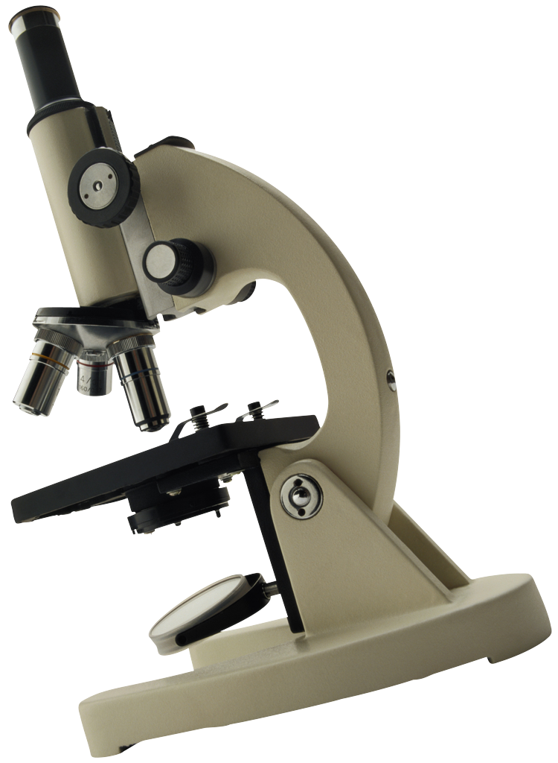
Bigger & Better ?
The goal of iCER is NOT:
Kflops / second
Instead, the goal of iCER IS:
KSciences / second
Doing More Science, Faster
Reducing the “Mean time to Science”
iCER is designed to help researchers do their science and when appropriate scale them up to national resources

Slide 9
Hardware Highlights
> 600 nodes, 7600 computing cores, 50 TB RAM
Large Memory Nodes (up to 6TB!)
GPU clusters (K20, M1060)
Xeon PHI cluster (5110p)
+ 8000-core condor cluster
High-speed file servers
360TB parallel scratch file space
1PB replicated home/research file servers
High-speed network (FDR,QDR,SDR,10g)
Evaluation nodes
Notes:
All of these resources are available to all researchers on our participating campuses.
Although the HPCC provided powerful hardware, the main researchers using the early system where pretty much engineering, physics and chemistry. These are departments already familiar with High Performance Computing. With this large of an investment the university wanted to get more out of the system and expand the usage and benefit of the system to the larger Research community.

Slide 10
Shared System
Development Nodes
Interactive computers for testing software and compiling code
Evaluation Nodes
Interactive computers for evaluating older and cutting edge systems
Queuing system
Submit jobs to the queue
Jobs will run as resources become available
Up to one-week walltime
Up to 520 processing cores per user at any time
The larger the job, the longer/harder it is to schedule

Slide 11
Software Stack
Compiled open-source software stack
Close to 2000 titles!
Optimized Math/Communications libraries
Some commercial software available
Due to licensing limitations we can not provide all of our software to WMU users
We can help install software for you
Full list: http://wiki.hpcc.msu.edu

Slide 12
Miscellaneous Musings
iCER provides many other services:
Data sharing (Globus Online Subscriptions)
Visualization Servers
Virtual Computing Lab
Specialized bioinformatics support (BICEP)
Support for scaling to XSEDE resources
+ … ?

Slide 13
Agenda
What is iCER / HPCC
Common classes problems
Overview of Hardware
Getting started, Seven Steps to High Performance
Running in parallel
Tips and tricks
Notes:
I designed this to be a high level talk to discuss the types of advanced computing resources that are available and how to get started and use these advanced computing systems. I will also give an overview of the most common classes of research problems solved using advanced computational hardware and some typical example problems.
First I will give you a quick overview of who I am and who I work for.

Slide 14
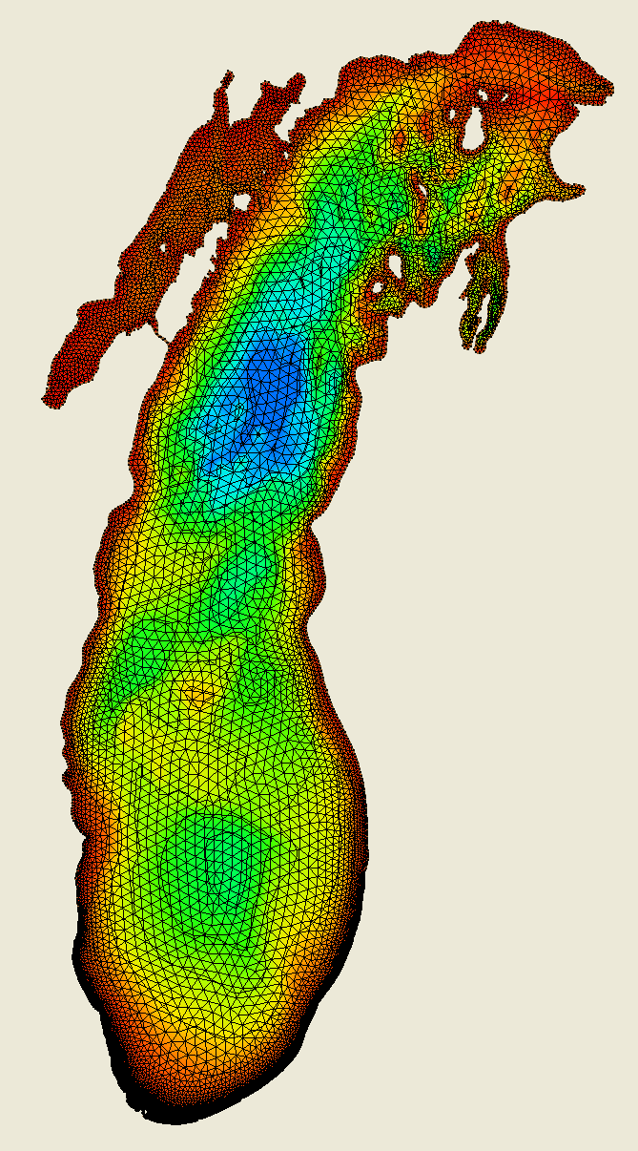

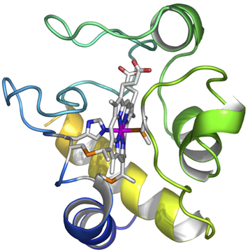


What problems are we solving?
Simulations
Data Analysis
Search
Images from, “Understanding the H₂ Emission from the Crab Nebula”, C.T. Richardson, J.A. Baldwin, G.J. Ferland, E.D. Loh, Charles A. Huehn, A.C. Fabian, P.Salomé
Image Provided by Dr. Mantha Phanikumar, MSU
Image Provided by Dr. Warren F. Beck, MSU
Notes:
I like to group all computational problems we run on the HPCC into three categories. Although not exact taxonomy, most problems fall into one or more of these categories.

Slide 15
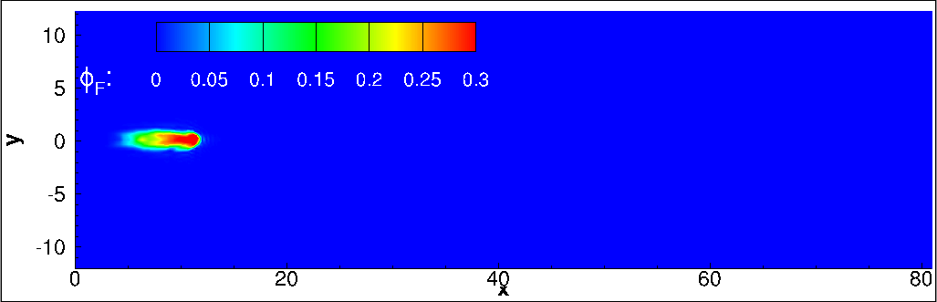
Simulations
Typically System of PDE (Partial Differential equations)
Fluid dynamics
Finite element analysis
Molecular dynamics
Weather
Etc.
Mathematically equivalent to inverse of a matrix
Premixed mixture of H2 -air auto igniting and flame propagation at supersonic flow Provided by Dr Jabari and Mani (Abolfazl) Irannejad
Notes:
The first one is boundary simulations…

Slide 16
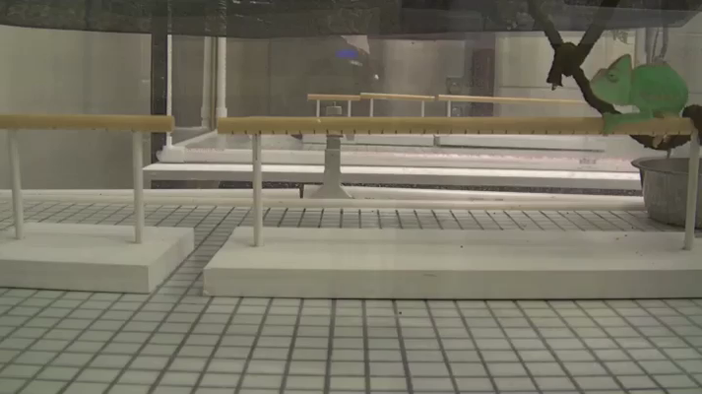
Data Analysis
Computer vision tasks
Some Bioinformatics
Astrophysics
Etc.
Video Provided by Dr. Fred Dyer

Slide 17
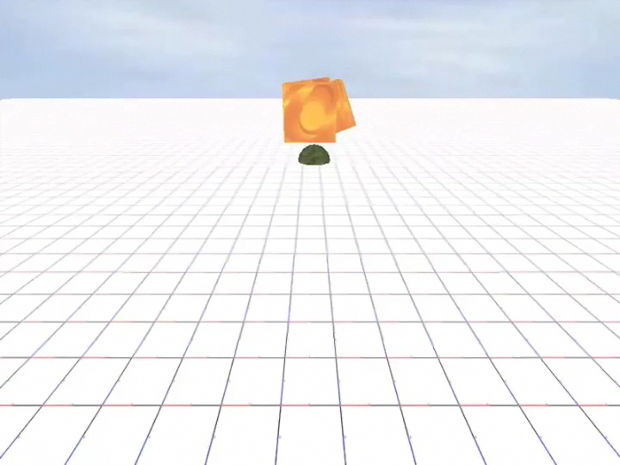
Search
Genome sequencing
Analytics
Optimization
Etc.
Evolution of an artificial organism that can move and forage for food, Dr. Nicolas Chaumont

Slide 18
Agenda
What is iCER / HPCC
Common classes problems
Overview of Hardware
Getting started, Seven Steps to High Performance
Running in parallel
Tips and tricks
Notes:
I designed this to be a high level talk to discuss the types of advanced computing resources that are available and how to get started and use these advanced computing systems. I will also give an overview of the most common classes of research problems solved using advanced computational hardware and some typical example problems.
First I will give you a quick overview of who I am and who I work for.

Slide 19
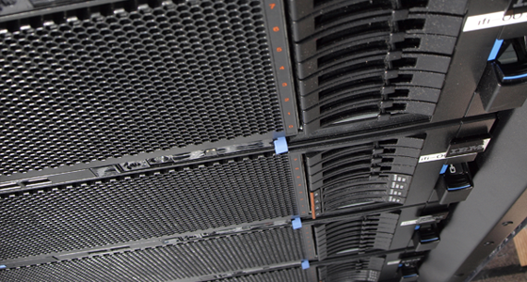
Large Shared Memory Systems (Fat Nodes)

Slide 20
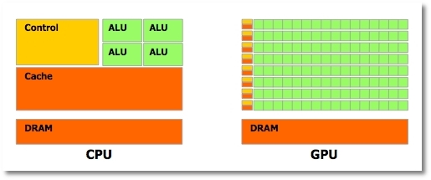
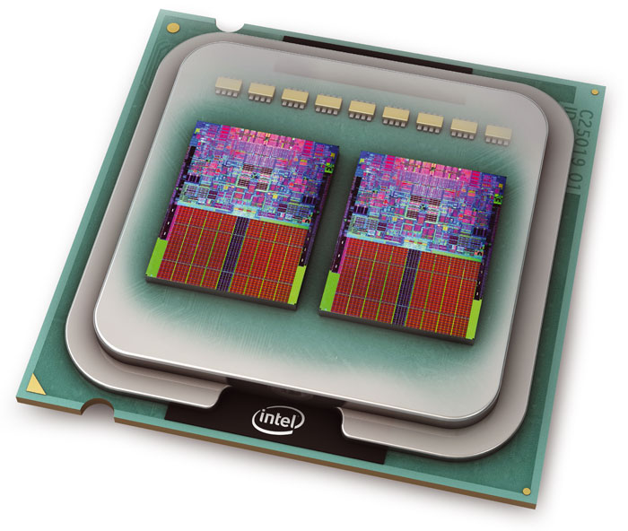
Shared Memory Communication
Fast!
Cores on a system share the same memory
OpenMP
Fat nodes
96 cores
6TB of memory

Slide 21

Accelerated Systems

Slide 22


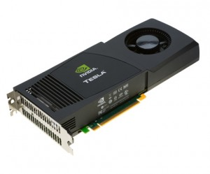
GPU
Cards used to render graphics on a computer
Hundreds of cores
Not very smart cores
But, if you can make your research look like graphics rendering you may be able to run really fast!

Slide 23
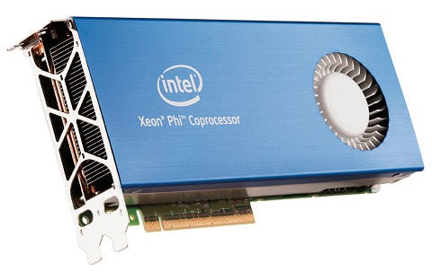
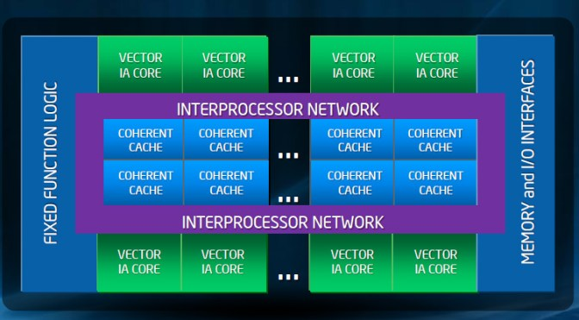
Intel Xeon Phi
Cross between CPU and GPU
About 61 Pentium III cores
Less cores/slower than GPU
Easier to use than GP

Slide 24

High Throughput HTCondor Cluster

Slide 25
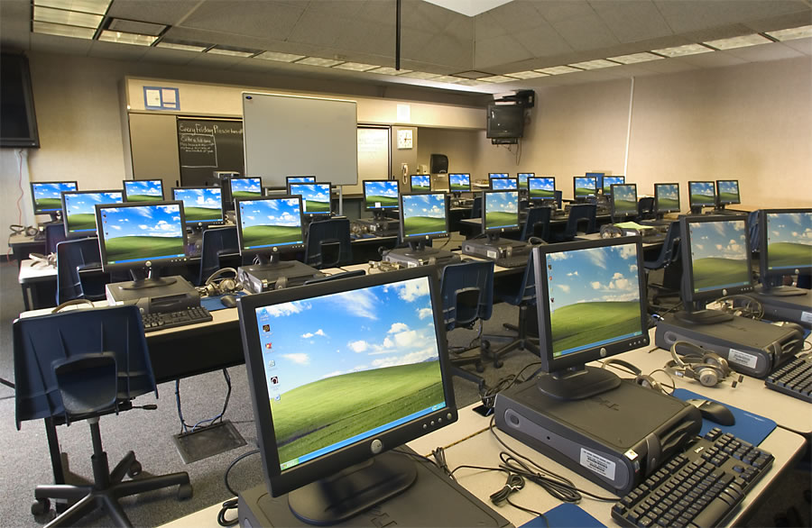

MSU HTCondor Cluster
Runs like a screen saver and Scavenges CPU cycles:
Approximately 400+ nodes
Approximately 7000 cores
Windows 7

Slide 26
Agenda
What is iCER / HPCC
Common classes problems
Overview of Hardware
Getting started, Seven Steps to High Performance
Running in parallel
Tips and tricks
Notes:
I designed this to be a high level talk to discuss the types of advanced computing resources that are available and how to get started and use these advanced computing systems. I will also give an overview of the most common classes of research problems solved using advanced computational hardware and some typical example problems.
First I will give you a quick overview of who I am and who I work for.

Slide 27
Steps in Using the HPCC
Get an account
Install needed software (SSH, SCP, X11)
Transfer input files and source code
Compile/Test programs on a developer node
Write a submission script
Submit the job
Get your results and write a paper!!

Slide 28
Accounts
Pis can request accounts though Don Weber:
donald.weber@wmich.edu
Each account has access to:
50 GB of replicated file spaces
520 processing cores
360 TB of high-speed scratch space
Also available: shared group folders
We have temporary accounts for today.
https://wiki.hpcc.msu.edu/x/vo2y
Notes:
Each user on the system starts with a 50gb account. If there is a need, users can request additional home directory space of up to 1 terabyte for free. Users also have shared access to a very large, very fast parallel scratch space.

Slide 29
Steps in Using the HPCC
Get an account
Install needed software (SSH, SCP, X11)
Transfer input files and source code
Compile/Test programs on a developer node
Write a submission script
Submit the job
Get your results and write a paper!!

Slide 30
Required Software
Secure Shell (ssh)
File transfer
Secure Copy (scp)
Mapping home directories
Graphical User Interface (x11)
Optional

Slide 31


Apple
Run Terminal program
ssh – already installed
ssh –X userid@hpcc.msu.edu
scp – already installed
scp ./mylocalfile userid@hpcc.msu.edu:~/mylocalfile
May need to install Xquarts (mac X11 Server)
Installer should be on USB drive

Slide 32
Windows Software
PuTTY:
http://www.chiark.greenend.org.uk/~sgtatham/putty/
Xming:
http://www.straightrunning.com/XmingNotes/
Xming install:
https://wiki.hpcc.msu.edu/x/swAk
WinSCP:
http://winscp.net

Slide 33

MobaXterm (windows)
Complete toolbox for remote computing:
Multi-tab terminal
X11 server
SSH
File transfer
More
Opensource
http://mobaxterm.mobatek.net/

Slide 34
Exercise: Portable HPCC
If you have Windows
Plug in your USB thumb drive
Open the thumb drive folder and select
PortableApps
You should see a new menu in your system tray for navigating

Slide 35
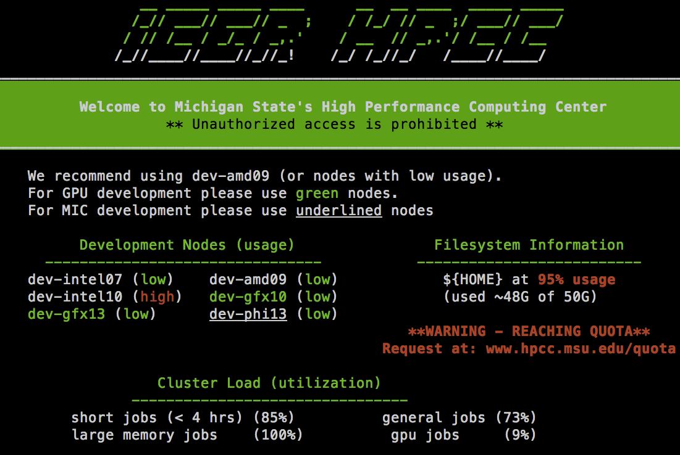
Exercise: Connect to HPCC
Step 1: Log into gateway.hpcc.msu.edu
Step 2: ssh into a dev node (developer node)
ssh dev-intel10
Step 3: execute a command
echo “Hello world”

Slide 36
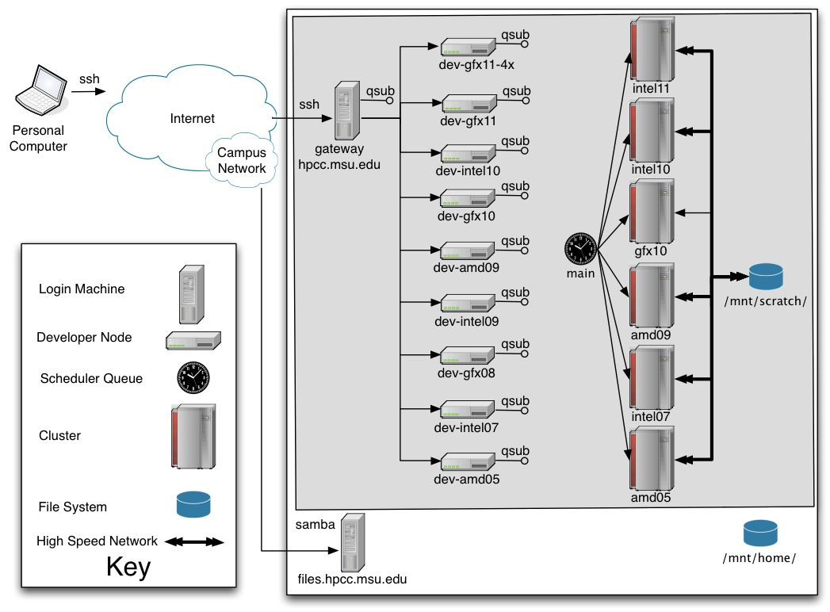
HPCC System Diagram

Slide 37
Command Line Interface
Command Line Interface (CLI)
Shell
Program to run Programs
Bash (Bourne Again Shell)
Use it because:
many tools only have command-line interfaces
allows you to combine tools in powerful new ways
More information, I recommend:
http://www.softwarecarpentry.org/

Slide 38
Module System
To maximize the different types of software and system configurations that are available to the users, HPCC uses a Module system
Key Commands
module avail – show available modules
module list – list currently loaded modules
module load modulename – load a module
module unload modulename – unload a module
module spider keyword – Search modules for a keyword

Slide 39
Exercise – Module
List loaded modules
module list
Show available modules:
module avail
Try an example (Shouldn’t work):
powertools

Slide 40
Exercise: getexample
Load a module:
module load powertools
Show powertools (should work now):
powertools
Run the “getexample” powertool
getexample
Download the helloworld example
getexample helloworld

Slide 41
Steps in Using the HPCC
Get an account
Install needed software (SSH, SCP, X11)
Transfer input files and source code
Compile/Test programs on a developer node
Write a submission script
Submit the job
Get your results and write a paper!!

Slide 42
SCP/SFTP – Secure File transfer
WinSCP for Windows
https://wiki.hpcc.msu.edu/x/Y4nh
Command-line “scp” and “sftp”on Apple/Linux
Many other scp and sftp clients out there as well
Functions over SSHv2 protocol, very secure

Slide 43
Steps in Using the HPCC
Get an account
Install needed software (SSH, SCP, X11)
Transfer input files and source code
Compile/Test programs on a developer node
Write a submission script
Submit the job
Get your results and write a paper!!

Slide 44
HPCC System Diagram

Slide 45
Advantages of running Interactively
You do not need to write a submission script
You do not need to wait in the queue
You can provide input to and get feedback from your programs as they are running

Slide 46
Disadvantages of running Interactively
All the resources on Interactive nodes are shared between all users.
Any single process is limited to 2 hours of cpu time. If a process runs longer than 2 hours it will be killed.
Programs that overutilize the resources on an integrative node (preventing other to use the system) can be killed without warning.

Slide 47
Steps in Using the HPCC
Get an account
Install needed software (SSH, SCP, X11)
Transfer input files and source code
Compile/Test programs on a developer node
Write a submission script
Submit the job
Get your results and write a paper!!

Slide 48
HPCC System Diagram

Slide 49
Submission Script
List of required resources
All command line instructions needed to run the computation

Slide 50
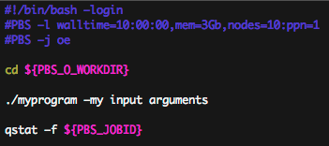
Typical Submission Script
Shell Comment
Define Shell
Resource Requests
Shell Commands
Special Environment Variables
Notes:
The most common schedulers such as Torque, use a submission script to tell the batch system what resources are needed and how to run.

Slide 51
Example: Submit a job
Go to the top helloworld directory
cd ~/helloworld
Look at the simple submission script
nano hello.qsub
Nano is a simple program you can use to edit text files on the HPCC
See bottom line of nano for commands the “^” character indicates the “control” key

Slide 52
hello.qsub
#!/bin/bash –login
#PBS –l walltime=00:10:00
#PBS –l nodes=1:ppn=1,feature=gbe
cd ${PBS_O_WORKDIR}
./hello
qstat –f ${PBS_JOBID}

Slide 53
Steps in Using the HPCC
Get an account
Install needed software (SSH, SCP, X11)
Transfer input files and source code
Compile/Test programs on a developer node
Write a submission script
Submit the job
Get your results and write a paper!!

Slide 54
Common Queue Commands
qsub <Submission script>
Submit a job to the queue
qdel <JOB ID>
Delete a job from the queue
showq –u <USERNAME>
Show the current job queue
checkjob <JOB ID>
Check the status of the current job
showstart –e all <JOB ID>
Show the estimated start time of the job.

Slide 55
Submitting a job
qsub –arguments <Submission Script>
Returns the job ID. Typically looks like the following:
5945571.cmgr01
Time to job completion
Queue
Run
Time
Notes:
One thing to remember… Throwing more resources at a problem may make the run time faster. However, it will also make the job harder to schedule and therefore make it sit in the queue longer.

Slide 56
Example: Submit a job, cont.
Submit the file to the queue
qsub hello.qsub
Record jobid number (######) and wait at most 30 seconds
Check the status of the queue
showq –u ${USER}

Slide 57
Example: Monitor a job
Get the status of the job:
qstat –f ######
When will a job start:
showstart –e all ######

Slide 58
Scheduling Priorities
Jobs that use more resources get higher priority (because these are hard to schedule)
Smaller jobs are backfilled to fit in the holes created by the bigger jobs
Eligible jobs acquire more priority as they sit in the queue
Jobs can be in three basic states:
Blocked, eligible or running

Slide 59
Current Cluster Resources
Year | Name | Description | ppn | Memory | Nodes | Total Cores
2007 | intel07 | Quad-core 2.3GHz Intel Xeon E5345 | 8 | 8GB | 126 | 1008
2010 | gfx10 | NVIDIA CUDA Node (no IB) | 8 | 18GB | 32 | 256
2010 | intel10 | Intel Xeon E5620 (2.40 GHz) | 8 | 24GB | 191 | 1528
2011 | intel11 | Intel Xeon 2.66 GHz E7-8837 | 32 | 512GB | 2 | 64
 |  |  | 32 | 1TB | 1 | 32
 |  |  | 64 | 2TB | 2 | 128
2014 | intel14 | Intel Xeon E5-2670 v2 (2.6 GHz) | 20 | 64GB | 128 | 2560
 |  |  | 20 | 256GB | 24 | 480
 |  | 2 NVIDIA K20 GPUs | 20 | 128GB | 40 | 800
 |  | 2 Xeon Phi 5110P | 20 | 128GB | 28 | 560
2014 | Intel14-XL | Intel Xeon E7-8857 v2 (3 GHz) | 48 | 1-3TB | 5 | 240
 |  |  | 96 | 6 TB | 1 | 96
 | Total |  |  |  | 580 | 7752

Slide 60
Job completion
By default the job will automatically generate two files when it completes:
Standard Output:
Ex: jobname.o5945571
Standard Error:
Ex: jobname.e5945571
You can combine these files if you add the join option in your submission script:
“#PBS -j oe”
You can change the output file name
#PBS -o /mnt/home/netid/myoutputfile.txt

Slide 61
Other Job Properties
resources (-l)
Walltime, memory, nodes, processor, network, etc.
#PBS –l feature=gpgpu,gbe
#PBS –l nodes=2:ppn=8:gpu=2
#PBS –l mem=16gb
Email address (-M)
Ex: #PBS –M colbrydi@msu.edu
Email Options (-m)
Ex: #PBS –m abe
Many others, see the wiki: http://wiki.hpcc.msu.edu/

Slide 62
Steps in Using the HPCC
Get an account
Install needed software (SSH, SCP, X11)
Transfer input files and source code
Compile/Test programs on a developer node
Write a submission script
Submit the job
Get your results and write a paper!!

Slide 63
Agenda
What is iCER / HPCC
Common classes problems
Overview of Hardware
Getting started, Seven Steps to High Performance
Running in parallel
Tips and tricks
Notes:
I designed this to be a high level talk to discuss the types of advanced computing resources that are available and how to get started and use these advanced computing systems. I will also give an overview of the most common classes of research problems solved using advanced computational hardware and some typical example problems.
First I will give you a quick overview of who I am and who I work for.

Slide 64
What is the Bottleneck
Not enough Memory
Solution: use a bigger node (6tb 96 cores)
Slow File I/O
Solution: use scratch
Solution: use a ram disk
Too many calculations
Solution: run your code in parallel

Slide 65
Steps to parallel code
Note: Every application is different
Analyze your code
Profilers (gprof, vtune, map, perfreport, tau)
Debuggers / memory trackers (gdb, ddt, totalview)
Optimize calculations
Trade memory for time (i.e., never do the same calculation twice)
Find ways to parallelize
Look for loops
Find iterations independent from each other
Determine how much information needs to be transferred
Notes:
Lets say your computation is CPU bound and is too slow. How do you make it go faster?
So I was walking down campus at night and I saw a friend of mine next to a street light, looking for his keys in the grass. Being the friend that I am, I stopped and helped him look. We where there probably 20 minutes and still could not find the keys. I finally asked him how he dropped them and he said they fell out of his paints while he was riding his bike over there and he pointed about twenty feet down the sidewalk. I then asked him why we where looking for the keys here and he said, “the light is better over here”.
-- Wait for laugh -- ☺
I have worked with a lot of programmers trying to optimize their code. I sometime ask, “why are you trying to optimize this portion of code” and the answer is because they know how to optimize that portion of the code and do not know how to optimize the bottle neck. If your program takes three days to run it really doesn’t matter much if it takes 10 minutes to load your data if you only do it once. You should spend your time focusing on the part of the code that you do 100,000 times and takes 10 seconds each time
A profiler can be used to determine how long each part of your program takes and where your bottle necks are.
Once you know where your bottle necks are, the next step is to optimize your algorithm (if you can). There is always a tradeoff for how much you can optimize the algorithm the time it takes to do the optimization.
Finally when you are finished with the algorithm the next goal is typically to throw hardware at the problem. You want to divide the computation out so that it will run across many cpus at the same time.

Slide 66

Single Thread Jobs
One CPU can only run one thing at a time. (sort of)
Time
Notes:
Typically we think of programs in a linear way. Data is input, some computation is done and then you get the results and publish a paper. However, in many cases scientists need to be able to take advantage of advanced computing hardware in order to get their research done in a reasonable amount of time.

Slide 67
Pleasantly Parallel
Time

Slide 68
Loosely Coupled
Time

Slide 69
Tightly Coupled
Time

Slide 70

Communication
Shared Memory
Shared Network
Distributed Network
Dedicated Accelerators
Hybrid Systems

Slide 71
Pleasantly Parallel

Slide 72
Pleasantly Parallel
Time

Slide 73
How fast can we go?
T - How long does each operation take?
N - How many operations do you need to run?
CPUs – Number of Cores job will run on.
Single CPU time estimate:
TxN
Best possible Pleasantly parallel time:
(TxN)*overhead/CPUs

Slide 74





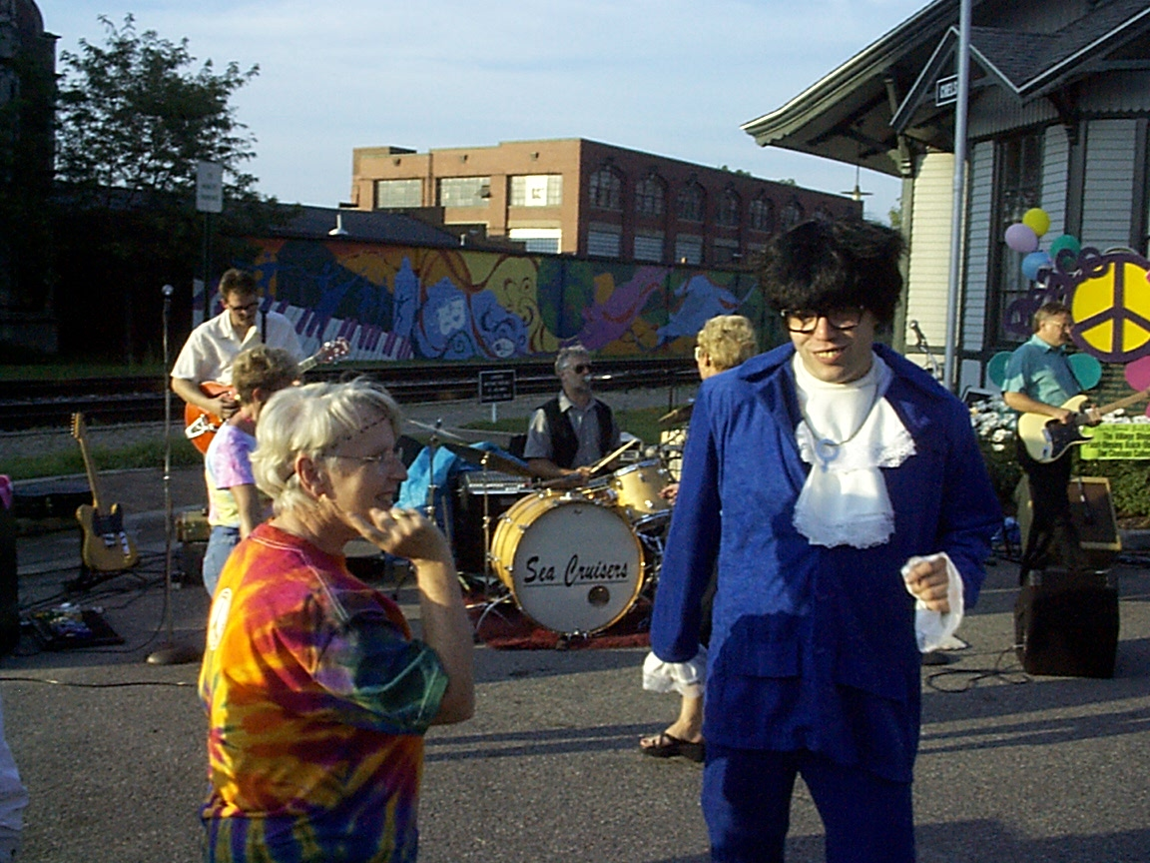



Who are you? -- Biometrics
Notes:
Lets look at a specific example from my research. Face recognition. Researchers look for algorithms that can identify who is the same and who is different.

Slide 75
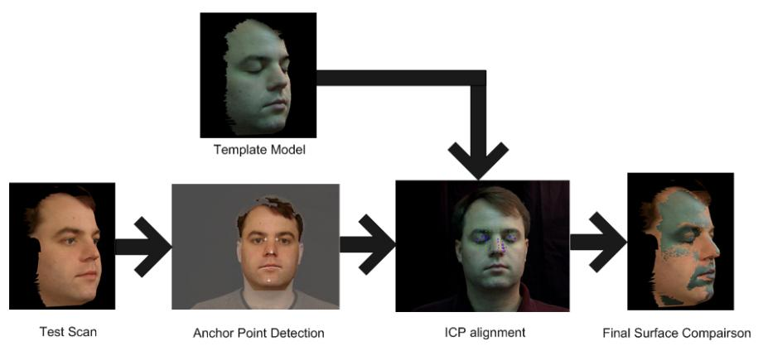
Pairwise-All Problem
Database of faces
Compare everything to everything else
Calculate a Matching score to use for identification
Notes:
To test these algorithms a large database is created and then matching scores are used to compare the different people in the database to see how well the proposed algorithm discriminates the data. Lets consider an example of a 3D face algorithm I worked on for my research

Slide 76
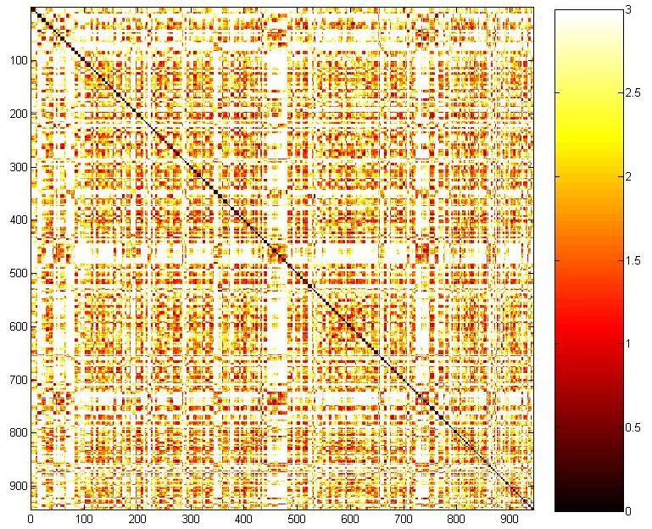

943 x 943 Similarity Matrix
Notes:
When we calculate a matching score for every face compared to every other face we get an image similar to the one shown here.
In this image the scans where sorted based on subjects so the Matching scores near the diagonal represent true accepts while the other scores represent imposter scores.

Slide 77
Estimated Calculation Times
Preprocessing
943 * 12 (seconds) ≈ 189 Minutes
Matching
943 * 943 * 5 (seconds) ≈ 103 Days
Scans matched to themselves always result in 0 mm
(943 * 943 – 943) * 5 (seconds) ≈ 103 Days
The Proposed Alignment Algorithm is symmetric.
(943 * 943 – 943)/2 * 5 (seconds) ≈ 51.5 Days
We also load models once per row instead of every time
(943*943-943)/2 * 3 (seconds) + 943 * 2 (seconds) ≈ 31 Days
Notes:
Just loading the data takes time because the 3D data is stored as ASCII files. As a preprocessing step, we load each file and then save it as our own binary file format. Our binary format only takes up to 2 seconds to load.
We estimate that the loading and comparison of each pair of scans takes about five seconds on computers in a lab. If we compare all 943 scans to each other then the algorithm would take over one hundred days to complete.
However, it is not really necessary to compare all 943 scans to each other. We can easily eliminate the diagonal because any scan compared to itself will always have a matching score of 0mm. However, eliminating these 943 comparisons do not help us out much.
One nice thing about our alignment algorithm is that we designed it to be symmetrical, I.e. if you compare scan A to scan B you will get the same matching score as if you compared scan B to scan A. This means we only have to do half of the full similarity matrix and just copy the values to the other half.
Now we have a significant improvement and we are down to about 50 days of processing time.
I also realized that we do not have to load each pair of scans for every comparison. Instead, we can load a model scan for a row and keep it in memory as we compare it to the other scans. This eliminates about 2 seconds of scanning time for almost all of the matches.
By doing the rows as groups, we only have to process this matrix for 31 days.
31 days is much better than 103 days. However, I still didn’t want to spend this much time.
We also had another problem. If the computer crashed while running the system, we did not have a mechanism to restart the system.

Slide 78
Calculation Time for Full Similarity Matrix
103 Days
51 Days
31 Days
2.5 Days
Notes:
We ran this system on 32 computers in one of our computer labs
This extra coding gave us a nice bonus in processing time. In the end it only took us 2 and a half days to process the entire similarity matrix.

Slide 79
How do we go even bigger?
5000 scans.
1.5 years on a single processor computer
13 days on our ad-hoc cluster.
1.5 days a commodity cluster at MSU
79
Notes:
79
Now consider the newest FRGC dataset that has 5000 scans. On a single processor it would take 1.5 years. It would take 13 days on my 32 node ad-hoc cluster. I did this experiment and got it to run at 1.5 days on our high performance computing cluster.

Slide 80
Steps to Pleasantly Parallel
Figure out command line
Estimate single job time:
Should be > 5 minutes
Should be < 1 week
Best if < 4 hours
Make a submissions script
Submit Job

Slide 81
Pleasantly Parallel Example
Folder full of input files:
Want folder full of output files:
Command Syntax:
./myprogram inputfile > outputfile
1.in | 5.in | 9.in | 13.in | 17.in
2.in | 6.in | 10.in | 14.in | 18.in
3.in | 7.in | 11.in | 15.in | 19.in
4.in | 8.in | 12.in | 16.in
1.out | 5.out | 9.out | 13.out | 17.out
2.out | 6.out | 10.out | 14.out | 18.out
3.out | 7.out | 11.out | 15.out | 19.out
4.out | 8.out | 12.out | 16.out

Slide 82
PBS Job Arrays
One submission script copied many times
Uses the PBS –t option
Ranges: 1-10
Lists: 2,4,100,3
Combination: 1-10,20,50,100
Distinguish between jobs by using the PBS_ARRAYID environment variable

Slide 83
Simple Job Array
#!/bin/bash –login
#PBS –l walltime=00:05:00,mem=2gb
#PBS –l nodes=1:ppn=1,feature=gbe
#PBS –t 1-19
cd ${PBS_O_WORKDIR}
mkdir ${PBS_ARRAYID}
Cd ${PBS_ARRAYID}
../myprogram ../${PBS_ARRAYID}.in > ${PBS_ARRAYID}.out
qstat –f ${PBS_JOBID}

Slide 84
Example: Job Arrays
Get the bleder_farm example:
getexample
getexample blender_farm
cd ./blender_farm
Look at the qusb file, using “less” command
less blender_farm.qsub
Submit the job
qsub blender_farm.qsub

Slide 85
HPCC Job array limitations
Can not have more than 520 cores running at once
Can not submit more than 1000 jobs at once
Each job can not run longer than one week
Lots of ways to work around these limitations

Slide 86
Job array numbers
All numbers in a job array have the same base number
7478210
Each PBS_ARRAYID is show in square brackets
7478210[1]
7478210[2]
Delete all jobs using one command
qdel 7478210[]

Slide 87
Files as Semaphores (FAS)
Use a list of input files as your task list
Use a list of output files (or flag files) as your in-progress/complete list
Rely on the file system to ensure that no two jobs are selected at the same time (not a great assumption but it works)

Slide 88
Simple FAS
#!/bin/bash –login
#PBS –l walltime=00:05:00
#PBS –l nodes=1:ppn=1,feature=gbe
#PBS –t 1-100
cd ${PBS_O_WORKID}
sleep $(( ${RANDOM} % 100 ))
for file in *.in; do
output=“./${file%.*}.out”
if [ ! –f ${output} ]; then
touch ${output}
./myprogram ${file} > ${output}
qsub –t 0 –N ${PBS_JOBNAME} ${0}
exit 0
fi
done

Slide 89
Shared Memory Parallelization

Slide 90
Shared Memory
Different threads (cores, processes) communicate though pointers to the same memory location
Problems can occur if different threads write the same memory at the same time
Flags (also called locks and/or semaphores) are used to allow only one thread to access memory at the same time

Slide 91
Shared Memory Communication
Cores on a processor share the same memory
OpenMP
Fat nodes
96 cores
6TB of memory

Slide 92
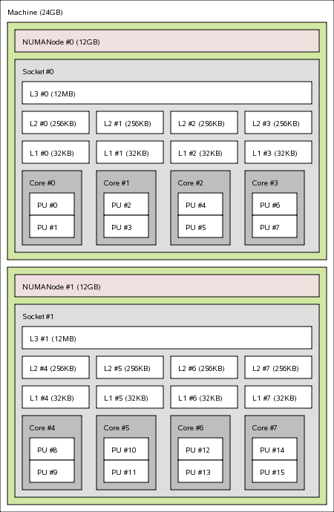
Intel10
8 cores
24 GB memory

Slide 93
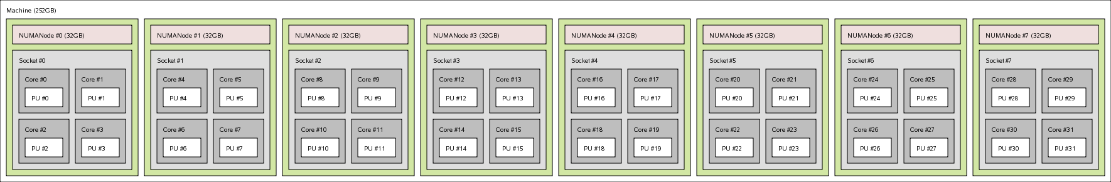
Large Memory Example
32 cores
256 GB memory
We also have nodes with up to 64 cores and 2TB of memory

Slide 94
NUMA

Slide 95
Shared memory submission scripts
Typically one node with multiple processors per node (ppn)
#PBS –l nodes=1:ppn=8
Different programs use different methods to tell them how many processors to use
Command line arguments
Environment variables

Slide 96
Example: shared memory Script
Bowtie uses shared memory parallelization
Get the bowtie example
getexample bowtie
Change to the bowtie directory
cd ./bowtie
Look at the submission script
less ./bowtie.qsub
Run the job
qsub bowtie.qsub

Slide 97
OpenMP
Common Shared Memory parallelizaiton
Single program runs in many threads
Really easy to pick loops that are parallel and split them into multi threads
Minor modifications to code that can be written not to affect single

Slide 98
OpenMP is easy
#include <omp.h>
...
#pragma omp parallel for
for (i=0;i<100;++i) {
A(i) = A(i) + B
}
...

Slide 99
Compile OpenMP Jobs
Use compiler option fopenmp.
fopenmp
Example:
gcc –fopenmp mycode.cc –o mycode

Slide 100
simpleOMP.qsub example
#!/bin/bash –login
#PBS –l walltime=00:01:00
#PBS –l nodes=1:ppn=5,feature=gbe
cd ${PBS_O_WORKDIR}
export OMP_NUM_THREADS=${PBS_NUM_PPN}
./simpleOMP
qstat –f ${PBS_JOBID}

Slide 101
Try another getexample
getexample helloOpenMP
getexample OpenMP_profiling

Slide 102
Shared Network Parallelization

Slide 103
MPI program (1 of 4)
/* Needed for printf'ing */
#include <stdio.h>
#include <stdlib.h>
/* Get the MPI header file */
#include <mpi.h>
/* Max number of nodes to test */
#define max_nodes 264
/* Largest hostname string hostnames */
#define str_length 50

Slide 104
MPI program (2 of 4)
int main(int argc, char **argv)
{
/* Declare variables */
int proc, rank, size, namelen;
int ids[max_nodes];
char hostname[str_length][max_nodes];
char p_name[str_length];
MPI_Status status;
MPI_Init(&argc, &argv);
MPI_Comm_rank(MPI_COMM_WORLD, &rank);
MPI_Comm_size(MPI_COMM_WORLD, &size);
MPI_Get_processor_name(p_name,&namelen);

Slide 105
MPI program (3 of 4)
if (rank==0) {
printf("Hello From: %s I am the receiving processor %d of %d\n",p_name, rank+1, size);
for (proc=1;proc<size;proc++) {
MPI_Recv(&hostname[0][proc], \\
str_length,MPI_INT,proc, \\
1,MPI_COMM_WORLD,&status);
MPI_Recv(&ids[proc], \\
str_length,MPI_INT,proc, \\
2,MPI_COMM_WORLD,&status);
printf("Hello From: %-20s I am processor %d of %d\n",&hostname[0][proc], ids[proc]+1, size);
}

Slide 106
MPI program (4 of 4)
} else { // NOT Rank 0
srand(rank);
int t = rand()%10+1;
sleep(t);
MPI_Send(&p_name,str_length, \\
MPI_INT,0,1,MPI_COMM_WORLD);
MPI_Send(&rank,str_length, \\
MPI_INT,0,2,MPI_COMM_WORLD);
}
MPI_Finalize();
return(0);
}

Slide 107
Trying out an example
Log on to one of the developer nodes
Load the powertools module:
module load powertools
Run the getexample program. This will create a folder called helloMPI:
getexample helloMPI
Change to the helloMPI directory and read the readme files
Or just type the following on the command line:
./README

Slide 108
Accelerator Cards

Slide 109
GPU
Cards used to render graphics on a computer
Hundreds of cores
Not very smart cores
But, if you can make your research look like graphics rendering you may be able to run really fast!

Slide 110
Running on the GPU
Program Starts on the CPU
Copy data to GPU (slow-ish)
Run kernel threads on GPU (very fast)
Copy results back to CPU (slow-ish)
There are a lot of clever ways to fully utilize both the GPU and CPU.

Slide 111
Pros and Cons
Benefits
Lots of processing cores.
Works with the CPU as a co-processor
Very fast local memory bandwidth
Large online community of developers
Drawbacks
Can be difficult to program.
Memory Transfers between GPU and CPU are costly (time).
Cores typically run the same code.
Errors are not detected (on older cards)
Double precision calculations are slow (On older cards)

Slide 112
CUDA program (1 of 5)
#include "cuda.h"
#include <iostream>
using namespace std;
void printGrid(float an_array[16][16]) {
for (int i = 0; i < 16; i++){
for (int j = 0; j < 16; j++) {
cout << an_array[i][j];
}
cout << endl;
}
}

Slide 113
CUDA program (2 of 5)
__global__ void theKernel(float * our_array)
{
// This is array flattening,
//(Array Width * Y Index + X Index)
our_array[(gridDim.x * blockDim.x) * \\
(blockIdx.y * blockDim.y + threadIdx.y) + \\
(blockIdx.x * blockDim.x + threadIdx.x)] = \\
= 5;
}

Slide 114
CUDA program (3 of 5)
int main()
{
float our_array[16][16];
for (int i = 0; i < 16; i++) {
for (int j = 0; j < 16; j++) {
our_array[i][j] = 0;
}
}

Slide 115
CUDA program (4 of 5)
//STEP 1: ALLOCATE
float * our_array_d;
int size = sizeof(float)*256;
cudaMalloc((void **) &our_array_d, size);
//STEP 2: TRANSFER
cudaMemcpy(our_array_d, our_array, size, \\
cudaMemcpyHostToDevice);

Slide 116
CUDA program (5 of 5)
//STEP 3: SET UP
dim3 blockSize(8,8,1);
dim3 gridSize(2,2,1);
//STEP 4: RUN
theKernel<<<gridSize, blockSize>>>(our_array_d);
//STEP 5: TRANSFER
printGrid(our_array);
cudaMemcpy(our_array, our_array_d, size, \\
cudaMemcpyDeviceToHost);
cout << "--------------------" << endl;
printGrid(our_array);
}

Slide 117
Compile CUDA Jobs
Just like MPI, to compile an cuda program you need to use the cuda compiler wrappers:
nvcc simple.cu -o simple_cuda

Slide 118
Try a cuda getexample
getexample cuda
getexample cuda_clock
getexample cuda_hybrid
getexample NAMD_CUDA_example

Slide 119
Intel Xeon Phi
Cross between CPU and GPU
About 61 Pentium III cores
Less cores/slower than GPU
Easier to use than GP
MPI
OpenMP

Slide 120
Try a Phi Card example
getexample MIC_examples
getexample MKL_mic

Slide 121
Standard Libraries

Slide 122
Standard Libraries
When possible take advantage of parallel libraries
Easy to use
Saves time
Takes care of the parallel coding for you
Tested and vetted by the community

Slide 123
Math Kernel Library
getexample MKL_benchmark
getexample MKL_c_eigenvalues
getexample MKL_Example
getexample MKL_mic
getexample MKL_parallel

Slide 124
Other Libraries
fftw
BLAS
ACML
BLAS (Basic Linar Algibra)
Lapak
trilinos
petsc
Magma
Cudatools
Mumps

Slide 125
Which approach is the best?
Depends on what you are doing?
Depends on how much communication you need.
Depends on what hardware you have.
Depends on how much time you have.

Slide 126
My Recommendations
Pleasantly Parallel
Standard Libraries
OpenMP
OpenACC
OpenMP on Phi
MPI
MPI on Phi?
GPGPU
EASY
Hard

Slide 127
Agenda
What is iCER / HPCC
Common classes problems
Overview of Hardware
Getting started, Seven Steps to High Performance
Running in parallel
Tips and tricks
Notes:
I designed this to be a high level talk to discuss the types of advanced computing resources that are available and how to get started and use these advanced computing systems. I will also give an overview of the most common classes of research problems solved using advanced computational hardware and some typical example problems.
First I will give you a quick overview of who I am and who I work for.

Slide 128
Tips and Tricks Going beyond system Limits

Slide 129
Going beyond system Limits
More than 520 jobs
Jobs longer than 1 week
Taking advantage of more nodes

Slide 130
Finding more Nodes
Owners are guaranteed access to their buy-in node within 4 hours. If they are not using the node, others can use it:
#PBS –l walltime=04:00:00
Some of the nodes do not have Infiniband. If you are not using scratch and do not need between node communication you can access these nodes:
#PBS feature=gbe

Slide 131
Checkpoint / Restart
What?
Save the state of your program
Restart your program from the saved point
How?
Design into your program
BLCR (Berkley Lab Checkpoint Restart)
Condor Checkpoint Restart
Others
Why?
Robust jobs
As HPC scales … hardware failures are guaranteed
Longer jobs
Better science
Notes:
Check pointing is the ability to save your program before it is done calculating and then restart it later at a different time or even on a different machine. Typically you have to write the save and restart into each program. However, there are a few libraries now that will do this automatically by saving out the entire memory and system state and then loading it back in again.
As HPC scales to bigger and bigger system, hardware is guaranteed to fail. Failures need to be addressed at all levels, including the hardware, network, OS and the application. Check pointing your code allows the research to be robust to all types of hardware failures.
Users can also use check pointing to run longer jobs on systems with limited time resources.

Slide 132
Questions?
Software Carpentry (the basics):
http://www.softwarecarpentry.org/
Announcements:
https://wiki.hpcc.msu.edu/
Documentation and User Manual:
https://wiki.hpcc.msu.edu/x/A4AN
Training Videos:
https://www.youtube.com/user/icermsu
Western Michigan University contact:
donald.weber@wmich.edu
Online Chat:
http://www.hipchat.com/gYlrQfgah
Contact us:
wmichhelp@hpcc.msu.edu

